Slide 1
Welcome to the Class of 2026 Parent Orientation
Presented by Tabitha Pardue ,School Counselor {A-K} & Jamie Wallace, School Counselor {L-Z}

Slide 2
WHS Counseling Center

Slide 3
State Required Documents
All Students must have:
Birth Certificate (can not be a Mother’s copy)
TN Shot Record (with updated immunizations and documented physical)
Additional documents that may apply:
Custody documents (most recent signed by the Judge) If you have been to court for custody or visitation, regardless of your situation, these are state-required documents.

Slide 4
Counseling Services
Advising
Placement
Planning
Assessment
Counseling
Coordinating
Instructing
Referring
Programming
Consultation

Slide 5
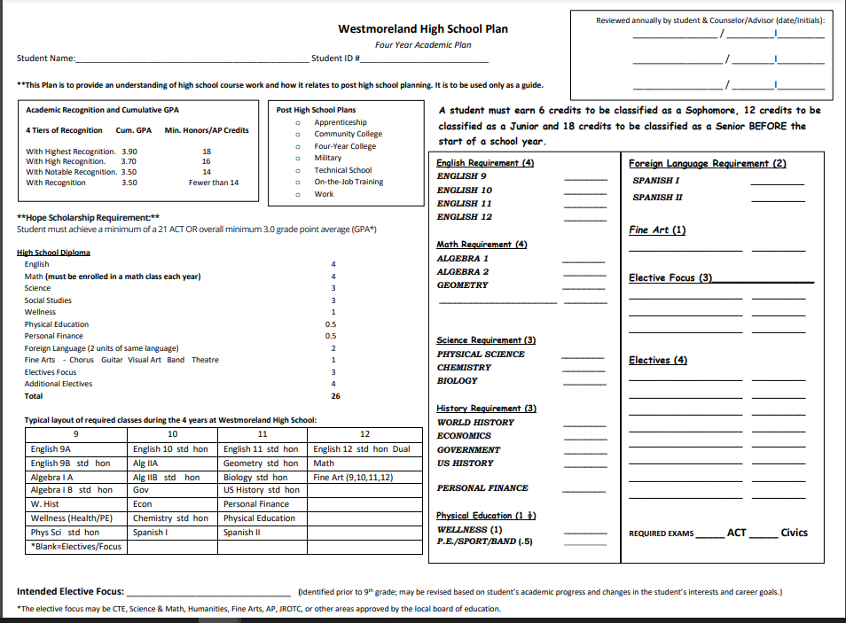
New Form

Slide 6
Student Registration Sheet
Course Requests
Focus Choices
Post-Secondary Education Plan-of-Study

Slide 7
Schedule Changes NO Schedule Changes Unless There is a Mistake
A Mistake is:
A Mistake is Not:
I have an empty block.
I am in a class I already took and passed.
I failed a class and need to retake it.
An administrator requests that I am removed from the class and placed in a different class.
My class block changed, and I don’t like it.
I am not in class with my friends (I don’t know anyone).
I want a different teacher.
I did not listen to the announcements and now I want to see if I can change an elective.
This Photo by Unknown Author is licensed under CC BY-SA

Slide 8
Academic Recognition
Placement
Class Standing
Tiers of Recognition

Slide 9
Honors Courses
English
A LOT of reading and writing
Required summer reading
Math
HOMEWORK!
Independent problem-solving
Self-motivated/self-disciplined
Science
Independent reading
TERMINOLOGY
Material covered at a fast pace
History
Outside reading
Critical thinking
Debates
Research Paper

Slide 10
Honors Courses Available to the Class of 2026
Grade 9
Honors English I
Honors Algebra I
Honors Physical Science
Honors World History
Honors Spanish I
____________
____________
Grade 10
Honors English II
Honors Geometry
Honors Algebra II
Honors Chemistry
Honors Spanish II
_____________
_____________
Grade 11
Honors English 11
Honors Applied Mathematics*
Honors Anatomy and Physiology
Honors US History
Honors Biology
Dual Public Speaking
_____________
_____________
Grade 12
Honors English IV (or Dual Enrollment)
Honors Calculus or Dual AP Statistics
Honors Physics
AP US History* (2 semesters)
Dual Psychology*
Dual Credit Plant Science*
______________
______________
*These courses may be offered at the same time.
Students who vary from this track may negatively impact their chance for top honors.

Slide 11
Guidelines for 9th grade classes
English 9A and 9B (RTI)
Algebra 1A and 1B (RTI)

Slide 12
Focus Choices

Slide 13
Yearly Checklist
Freshman Year
Sophomore Year
Junior Year
Senior Year
If you haven’t already, start a student portfolio which includes your
student’s accomplishments, awards, honors, volunteer hours, clubs, or organization involvement. This will help when applying to colleges, for scholarships, or filling out job applications.

Slide 14
College and Career Planning
9th Grade - YouScience.com
Aptitude/Interest –Career/College Planning-
10th Grade – Collegefortn.org
Interest inventory – Life Calculator
Career/College Planning
Money for College
11th Grade – CareerOneStop.com
Interest assessment
Work Values assessment
Skills assessment
ACT.org –Interest Inventory (Career Cluster)
12th Grade – ACT.org
Interest Inventory (Career Cluster)
My Next Move.org
National- O’Net Career Planning

Slide 15
Money For College
Scholarship Database
Visit Counseling Center webpage (scholarship information tab)
TIPS – Tennessee Investments Preparing Scholars 4-to-1 Matching Grant for qualifying families
Visit - TNStars.com/TIPS
For more information and qualifications
TN Promise – last dollar scholar applied for during Senior year
Attend mandatory meetings
8 hours of community service
TN Hope/Lottery Scholarship –
1. ACT Composite =21+
2. Grade Point Average = 3.0

Slide 16
Tennessee Scholars
Requirements
https://www.tennesseescholars.org

Slide 17
Additional Information
Math tutoring is provided mornings and afternoons.
Homework hotline is available Monday-Thursday from 4-8 pm.

Slide 18
Credit Recovery
Purpose:
Provides:
is to provide an after-school program on the student’s home campus that will ultimately receive a high school diploma.
an opportunity to receive credit for a course that the student has previously failed.

Slide 19
Testing Information
TN READY Assessments
ACT test (11th grade only)
Civics Test and Project Based Learning

Slide 20
Clubs and Organizations at Westmoreland High School
Chess Club Advisor: Mr. Gray
Student Council Advisor: Mr. Hopkins
Noah’s Promise Advisor: Mrs. Booker
HOSA Advisor: Ms. Hester
Beta/Academic team Advisor: Mrs.Brown/ Mrs. Beaver
FFA Advisor: Mrs. Garrison
FBLA Advisors: Mrs. Bradley
FCA Advisor: Mrs. Thomas
FCCLA Advisor: Dr. McDonald
Science Club Advisor: Mrs. Yankee
Band Advisor: Mrs.Peterson
Choir Advisor: Mrs. Driver
Mystery Club Advisor: Mrs.Peterson

Slide 21
Sports @ WHS
Girls Volleyball Coach: Ms. Michelle Gray
Cross Country/Track (Boys/Girls) Coach: Mr. Garrison
Golf Coach: Mr. Jason Graves
Soccer (Boys) Coach: Mr. Garrison
Basketball (Boys) Coach: TBA
Basketball (Girls) Coach: Mr. E.J. Perry
Baseball Coach: Mr. Will Troutt
Softball Coach: Mrs. Kyla Creasy
Football Coach: Mr. Chad Perry
Cheerleading Coach: Mrs. Jessica Thomas

Slide 22
Welcome to Westmoreland High School

Slide 23
What You Can Do for Your Student

Slide 24
1st Day Procedures
Enter the building through the front (car riders), back (bus riders)
Stay in the main hallway or 1st and 2nd wings until the bell rings at 7:55 to report to Homeroom
Homerooms can be found on posters on the wall in front of the library (Class of 2026/9th grade and last name)
Be in homeroom before 8 AM to get new schedules and go over school handbook

Slide 25
Westmoreland High School Daily Bell Schedule
7:30 am Staff arrives
7:45 am 15-min warning
7:55 am Warning Bell
Monday-Tuesday-Thursday-Friday Wednesday
8:00 am Tardy Bell 8:00 am Tardy Bell
8:00 am -9:40am First Block 8-9:00 am First Block
9:05-9:40 am Enrichment
Monday-Friday
9:40 am-9:55 am Break
9:55 am -11:25 am Second Block
11:25 am- 11:30 am Class Change
11:30 am – 1:25 pm Third Block and Lunch
1:25 pm- 1:30 pm Class Change
1:30 pm – 3:00pm Fourth Block

Slide 26
Semester and Quarter Classes
Semester Classes : August-December
(1 credit) January – May
Quarter Classes: Q1 = Week 1 – 9
(.5 credit) Q2 = Week 10-18
Q3 = Week 19-27
Q4 = Week 28-36

Slide 27
Every Day Matters

Slide 28
Absences

Slide 29
Attendance Is Important

Slide 30
Google Classroom
WHS Class of 2026
Code: twzojoq

Slide 31
Questions?
Remember our website can be accessed 24/7
www.whscounselingcenter.weebly.com
Or www.whs.sumnerschools.org click on Guidance to find a link to our webpage

Slide 32
Contact information
Tabitha Pardue {A-K} tabitha.pardue@sumnerschools.org
Jamie Wallace {L-Z} jamie.wallace@sumnerschools.org
615-644-2280

Slide 34
Thank you for your attendance and support!

